Slide 1
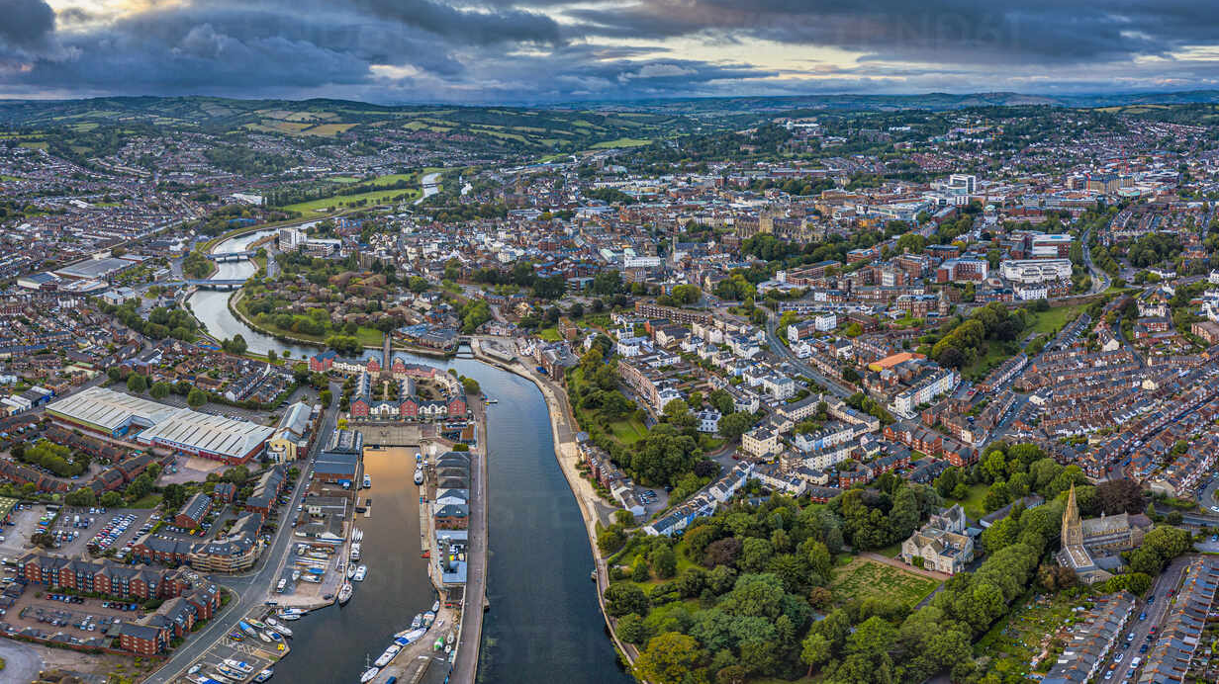



Junction X Exeter 2023
By: Amy Stell, Owen Saunders, Kornél Bartha

Slide 2
A recent study across 24 countries reveals 58% of adults are more mindful of their impact on the environment, and 85% said they’re willing to take personal action to combat environmental and sustainability challenges in 2021. (A. Banga, 2021)

Slide 3


What stops people from taking action?
They don’t know what action to take.
They do not have time to research new solutions.
They forget to act.
Our solution:
We provide people with a fun call to action.
We provide new ideas.
We ensure they remember to act.

Slide 4


Problems for companies who want to be more sustainable:
Competing with companies where profit and growth are prioritised over the environment.
Not having a platform to reach customers interested in sustainability.
Having to invest to be more sustainable.
What the company needs:
Being able to reach customers and having access to a platform which helps promote their business.
No need for big investments.

Slide 5



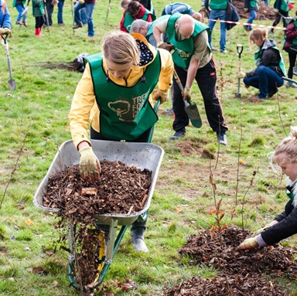
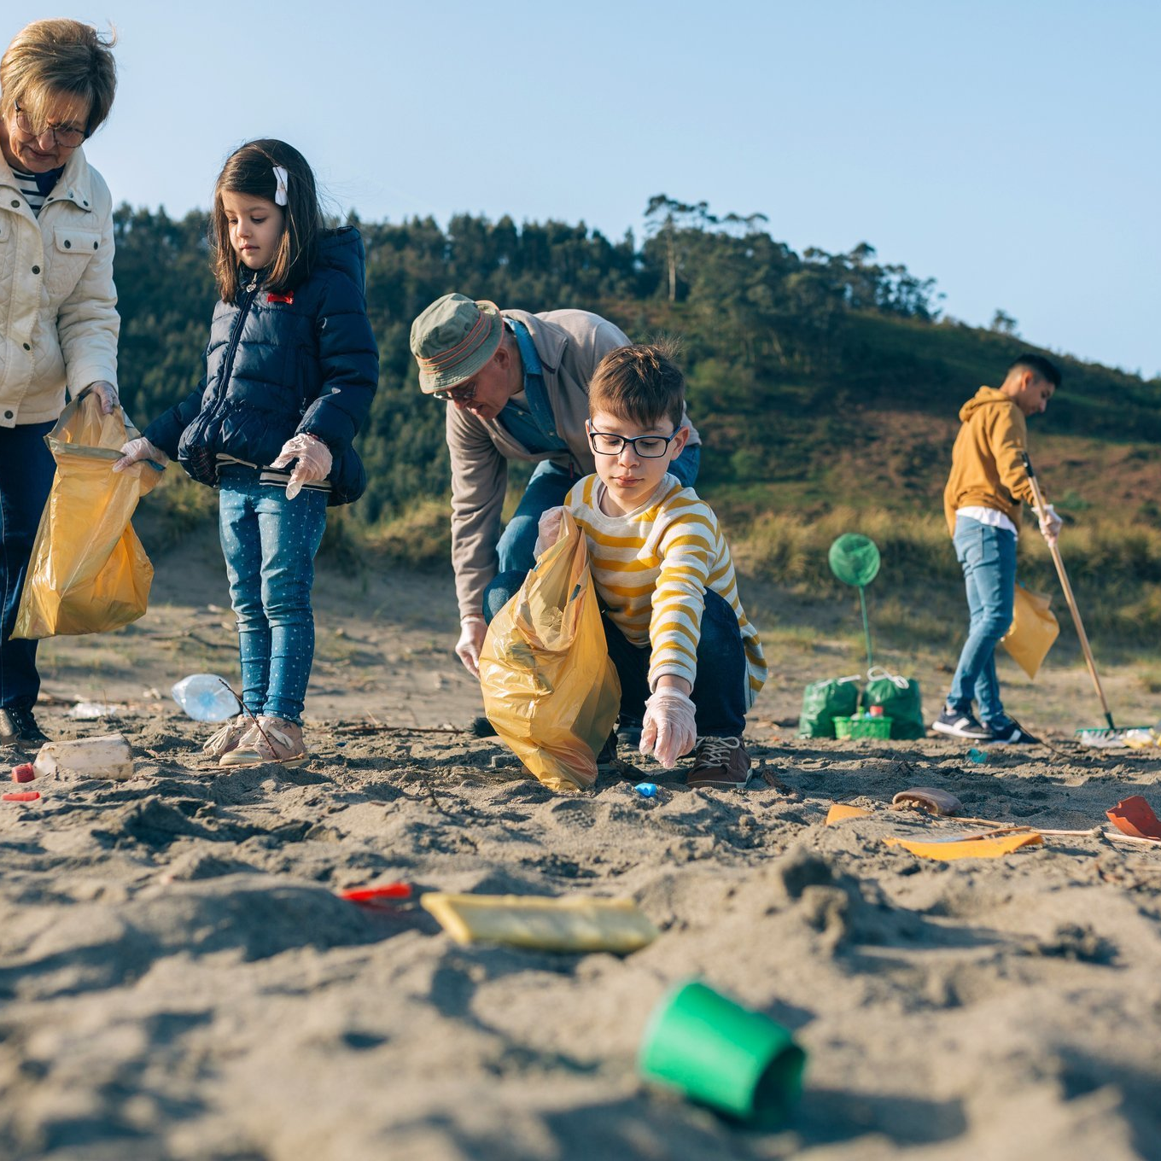

Sustainify’s challenges…
Encourage people to take action on sustainability.
Allow you to connect with likeminded friends.
Provides a platform where companies can promote local sustainability initiatives.
Incentivises action with immediate rewards.
Daily
Weekly
Monthly
Yearly

Slide 6




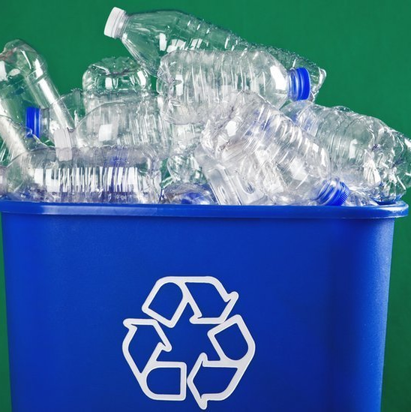
We track five key sustainability statistics
Emissions prevented in kilotons of Co2 equivalent
Water saved in litres
Energy saved in kilowatts.
Plastic use prevented in plastic bottles.
Trees saved by number of trees.
Notes:
Connect with friend
Support local businesses
Gain instant discounts and save money.
Directly take part in projects.

Slide 7
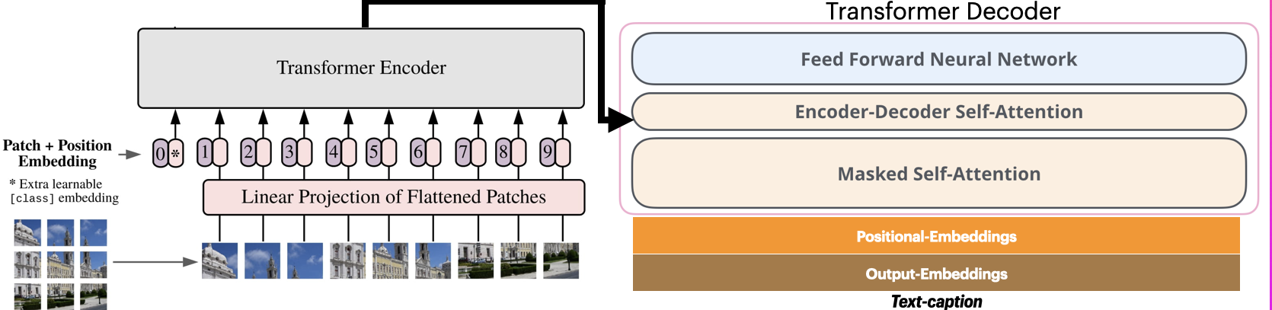

How do we do this?
By using object detection and image recognition to verify completing of challenges.
Having an interface that allows us to target companies based on their values and sustainability agenda.

Slide 8
Act now to show that you care, influence your community.

